Slide 1
Time -Varying Fields and Maxwell’s Equations

Slide 2

MAXWELL’s EQUATION FOR STATIC FIELDS
RECALL
$∇·\vec{D}=ρ_{v}$ - First
$∇ x \vec{H}=\vec{J}$ - Second
$∇ x \vec{E}=0$- Third
$∇·\vec{B}=0$- Fourth

Slide 3
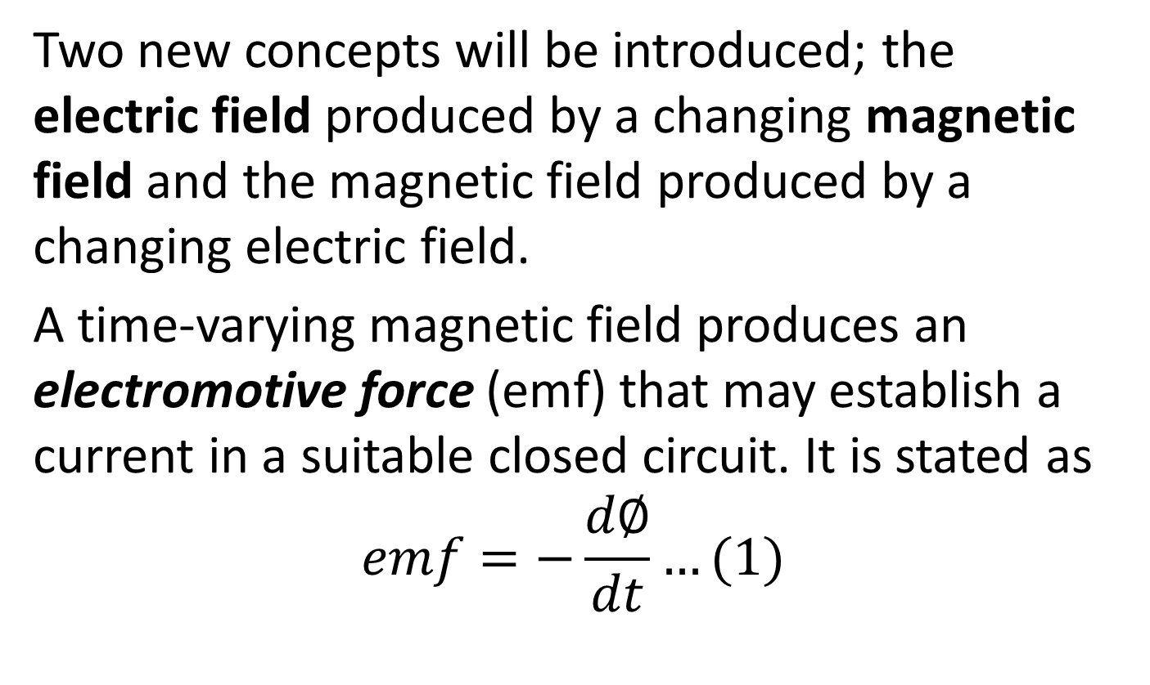
Faradays Law
Two new concepts will be introduced; the electric field produced by a changing magnetic field and the magnetic field produced by a changing electric field.
A time-varying magnetic field produces an electromotive force (emf) that may establish a current in a suitable closed circuit. It is stated as
$$emf=−\frac{d∅}{dt}…(1)$$

Slide 4
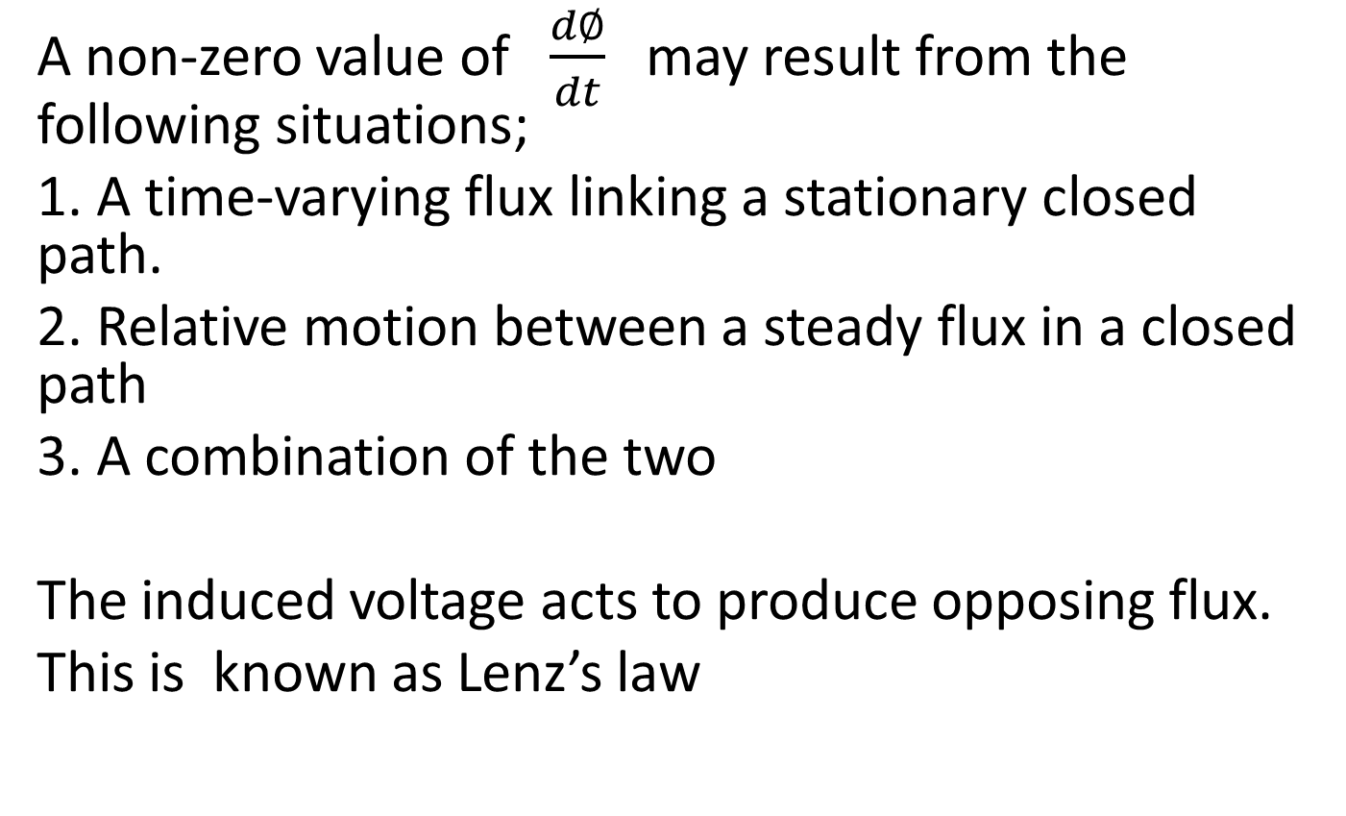
A non-zero value of $\frac{d∅}{dt}$ may result from the following situations;
1. A time-varying flux linking a stationary closed path.
2. Relative motion between a steady flux in a closed path
3. A combination of the two
The induced voltage acts to produce opposing flux.
This is known as Lenz’s law

Slide 5
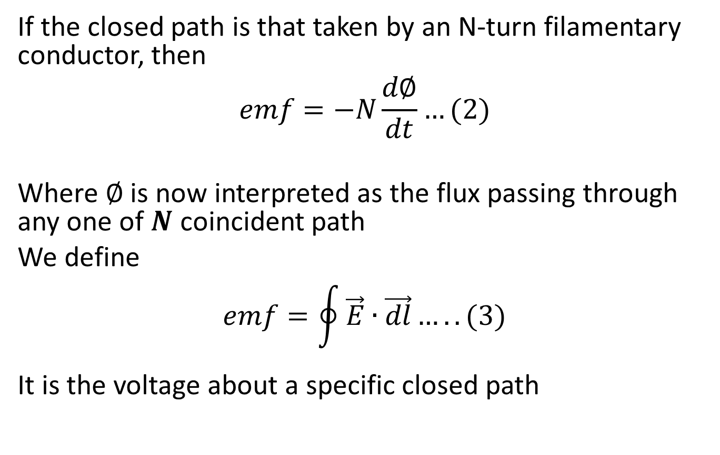
If the closed path is that taken by an N-turn filamentary conductor, then
$$emf=−N\frac{d∅}{dt}…(2)$$
Where $∅$ is now interpreted as the flux passing through any one of $N$ coincident path
We define
$$emf=\oint{\vec{E}∙\vec{dl}…..(3)}$$
It is the voltage about a specific closed path

Slide 6
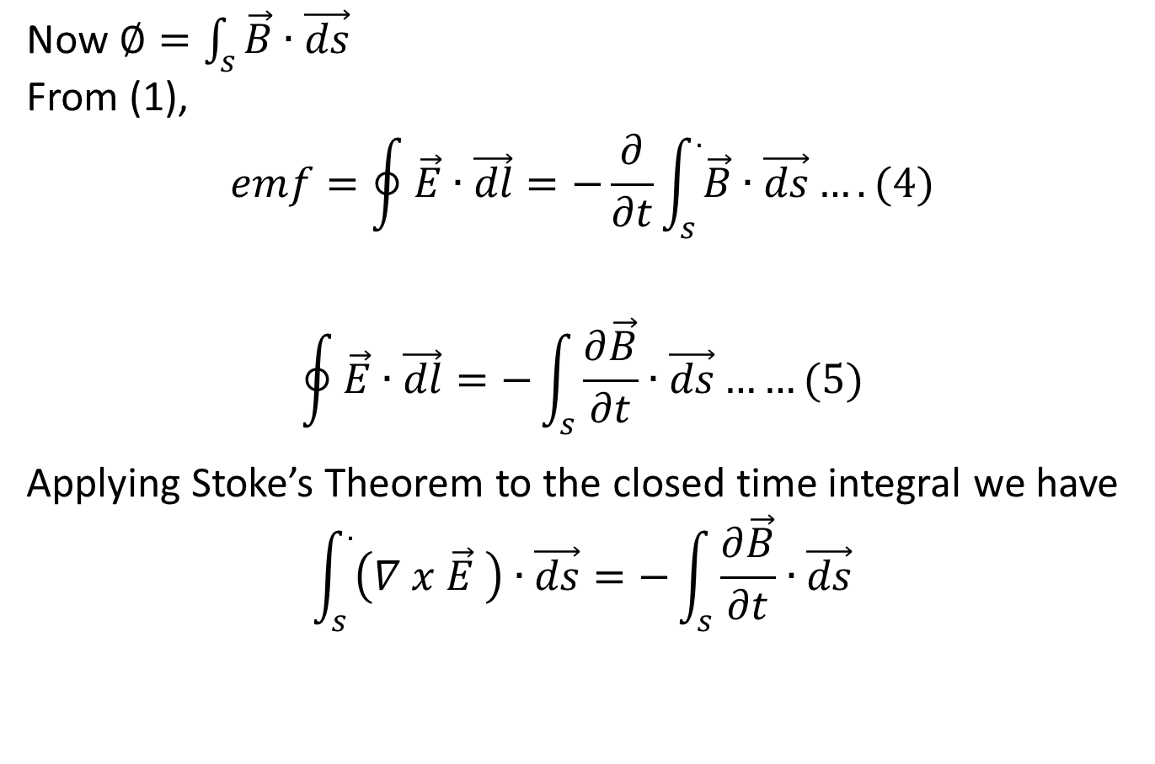
Now $∅=\int_{s}{\vec{B}∙\vec{ds}}$
From (1),
$$emf=\oint{\vec{E}∙\vec{dl}=−\frac{∂}{∂t}\int_{s}^{.}{\vec{B}∙\vec{ds}}….(4)}$$
$$\oint{\vec{E}∙\vec{dl}=−}\int_{s}{\frac{∂\vec{B}}{∂t}∙\vec{ds}……(5)}$$
Applying Stoke’s Theorem to the closed time integral we have
$$\int_{s}^{.}{\left(∇ x \vec{E} \right)∙\vec{ds}}=−\int_{s}{\frac{∂\vec{B}}{∂t}∙\vec{ds}}$$

Slide 7
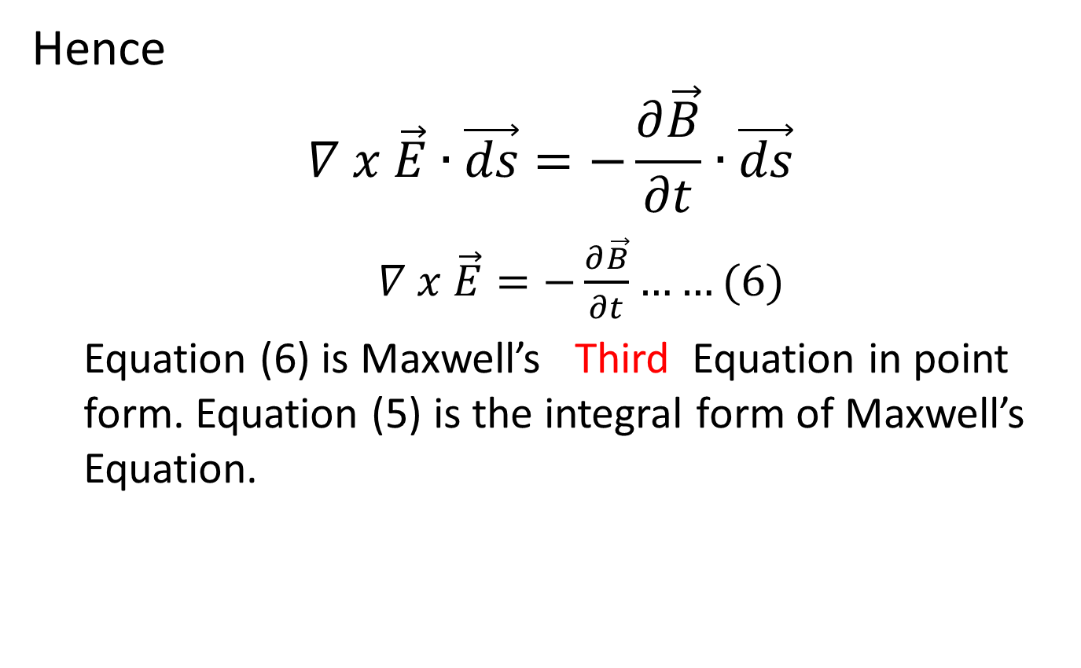
Hence
$$∇ x \vec{E}∙\vec{ds}=−\frac{∂\vec{B}}{∂t}∙\vec{ds}$$
$∇ x \vec{E}=−\frac{∂\vec{B}}{∂t}……(6)$
Equation (6) is Maxwell’s Third Equation in point form. Equation (5) is the integral form of Maxwell’s Equation.

Slide 8
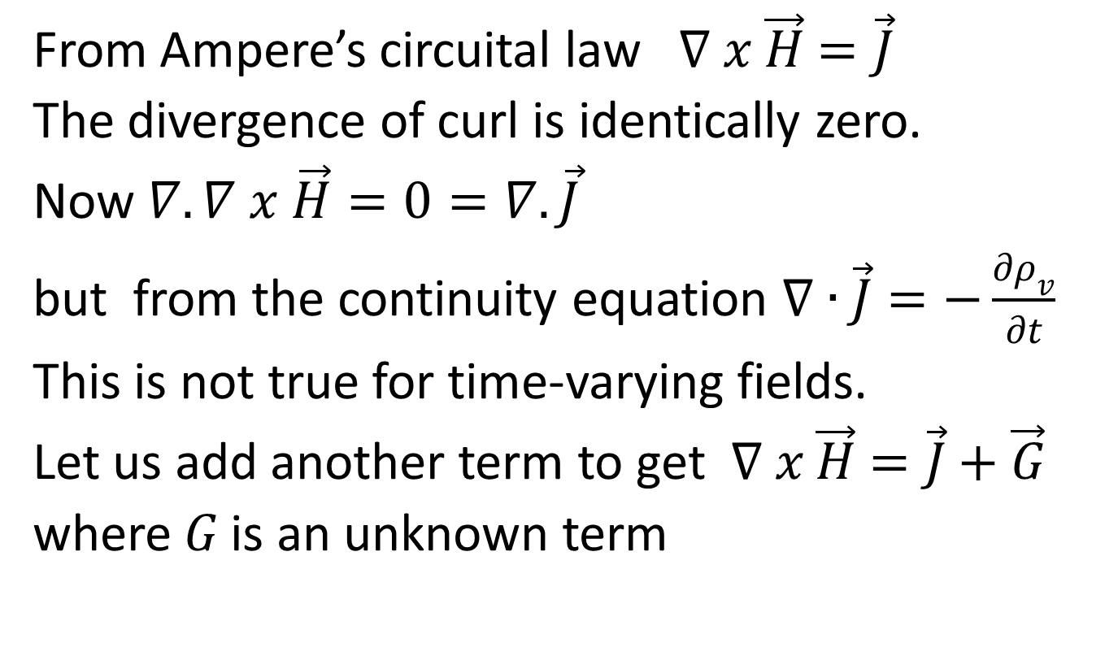
Displacement Current
From Ampere’s circuital law $∇ x \vec{H}=\vec{J}$
The divergence of curl is identically zero.
Now $∇.∇ x \vec{H}=0=∇.\vec{J}$
but from the continuity equation $∇∙\vec{J}=−\frac{∂ρ_{v}}{∂t}$
This is not true for time-varying fields.
Let us add another term to get $∇ x \vec{H}=\vec{J}+\vec{G}$
where $G$ is an unknown term

Slide 9

$$∇∙∇ x \vec{H}=0=∇∙\vec{J}+∇∙\vec{G}$$
Also
$$∇∙\vec{J}=−\frac{∂ρ_{v}}{∂t}$$
$$∇∙\vec{G}=\frac{∂ρ_{v}}{∂t}$$

Slide 10
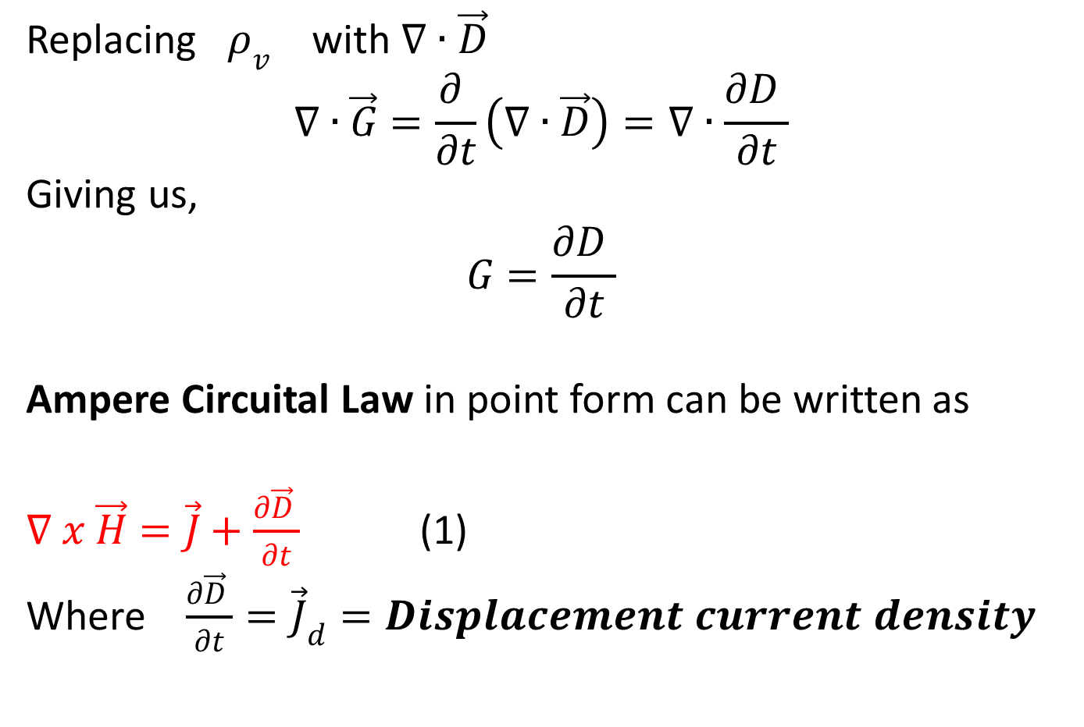
Replacing $ρ_{v}$ with $∇∙\vec{D}$
$$∇∙\vec{G}=\frac{∂ }{∂t}\left(∇∙\vec{D}\right)=∇∙\frac{∂D }{∂t}$$
Giving us,
$$G=\frac{∂D }{∂t}$$
Ampere Circuital Law in point form can be written as
$∇ x \vec{H}=\vec{J}+\frac{∂\vec{D} }{∂t}$ (1)
Where $\frac{∂\vec{D} }{∂t}={\vec{J}}_{d}=Displacement current density$

Slide 11
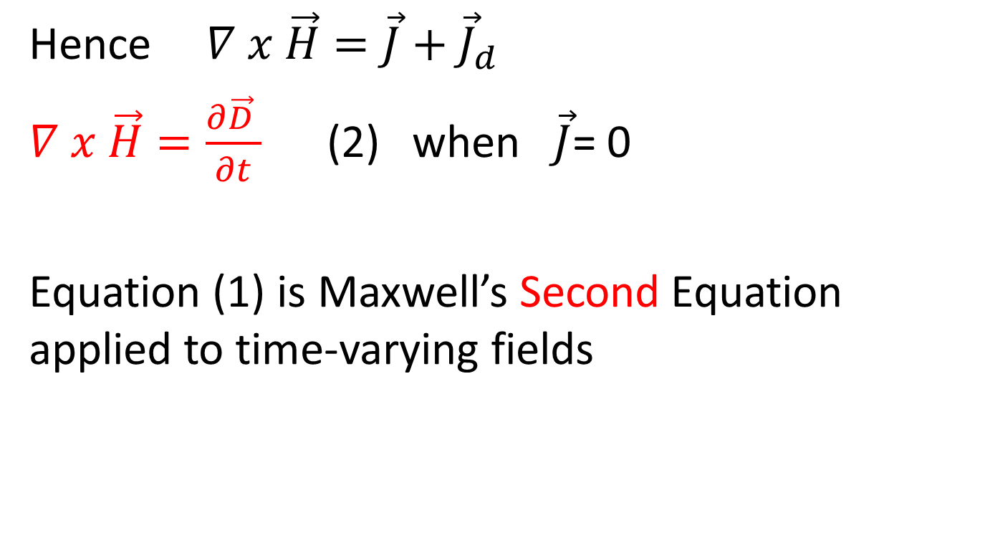
Hence $∇ x \vec{H}=\vec{J}+{\vec{J}}_{d}$
$∇ x \vec{H}=\frac{∂\vec{D} }{∂t}$ (2) when $\vec{J}$= 0
Equation (1) is Maxwell’s Second Equation applied to time-varying fields

Slide 12
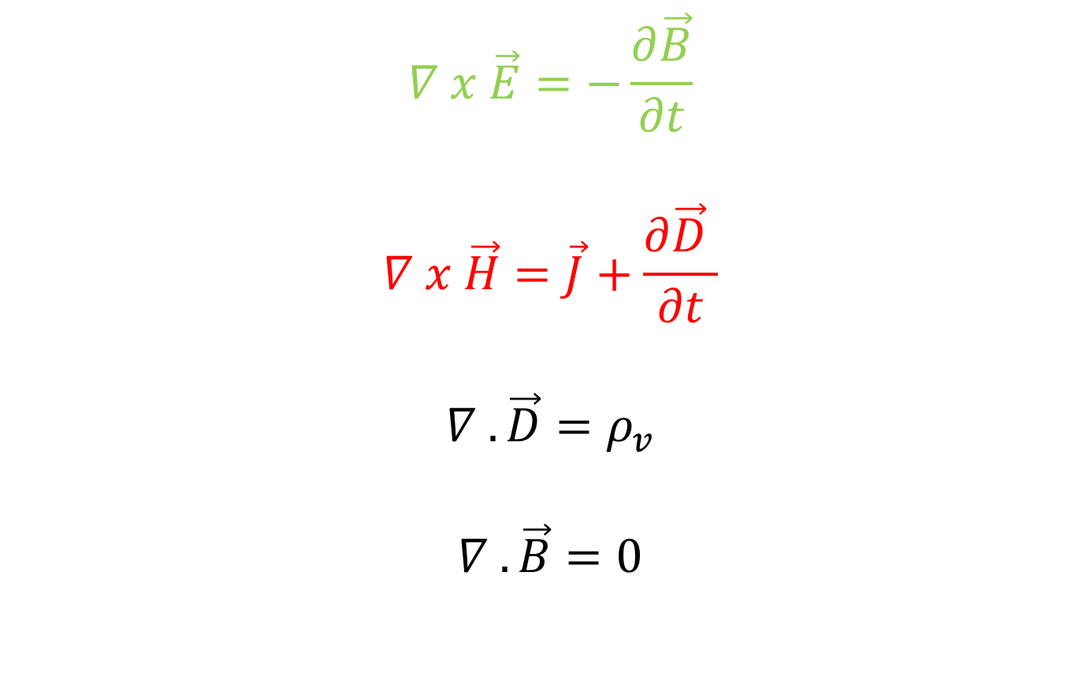
MAXWELL’S EQUATION IN POINT FORM
$$∇ x \vec{E}=−\frac{∂\vec{B}}{∂t}$$
$$∇ x \vec{H}=\vec{J}+\frac{∂\vec{D} }{∂t}$$
$$∇ . \vec{D}=ρ_{v}$$
$$∇ . \vec{B}=0$$

Slide 13
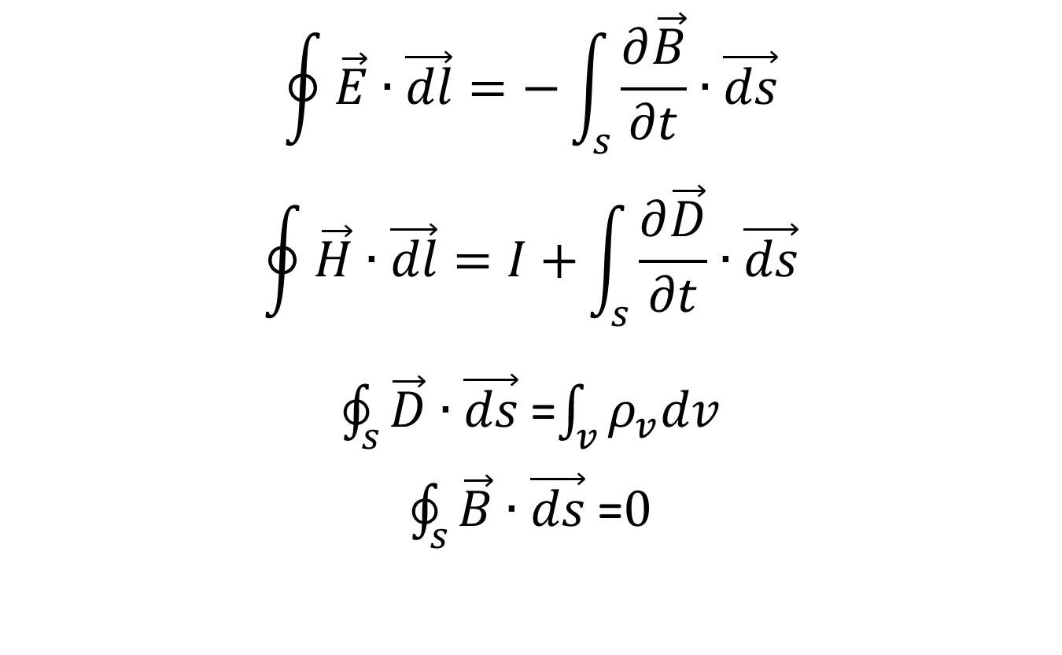
MAXWELL’S EQUATION IN INTEGRAL FORM
$$\oint{\vec{E}∙\vec{dl}=−}\int_{s}{\frac{∂\vec{B}}{∂t}∙\vec{ds}}$$
$$\oint{\vec{H}∙\vec{dl}=I+}\int_{s}{\frac{∂\vec{D}}{∂t}∙\vec{ds}}$$
$\oint_{s}{\vec{D}∙\vec{ds}}$=$\int_{v}{ρ_{v}dv}$
$\oint_{s}{\vec{B}∙\vec{ds}}$=$0$

Slide 14
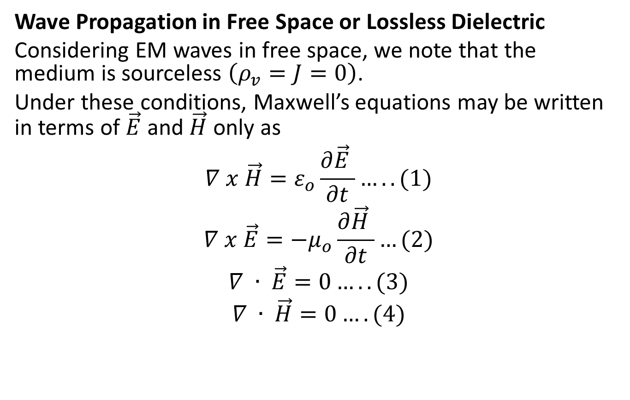
THE UNIFORM PLANE WAVE
Wave Propagation in Free Space or Lossless Dielectric
Considering EM waves in free space, we note that the medium is sourceless $\left(ρ_{v}=J=0\right)$.
Under these conditions, Maxwell’s equations may be written in terms of $\vec{E}$ and $\vec{H}$ only as
$$∇ x \vec{H}=ε_{o}\frac{∂\vec{E} }{∂t}…..(1)$$
$$∇ x \vec{E}={−μ}_{o}\frac{∂\vec{H} }{∂t}…(2)$$
$$∇ ∙ \vec{E}=0…..(3)$$
$$∇ ∙ \vec{H}=0….(4)$$

Slide 15
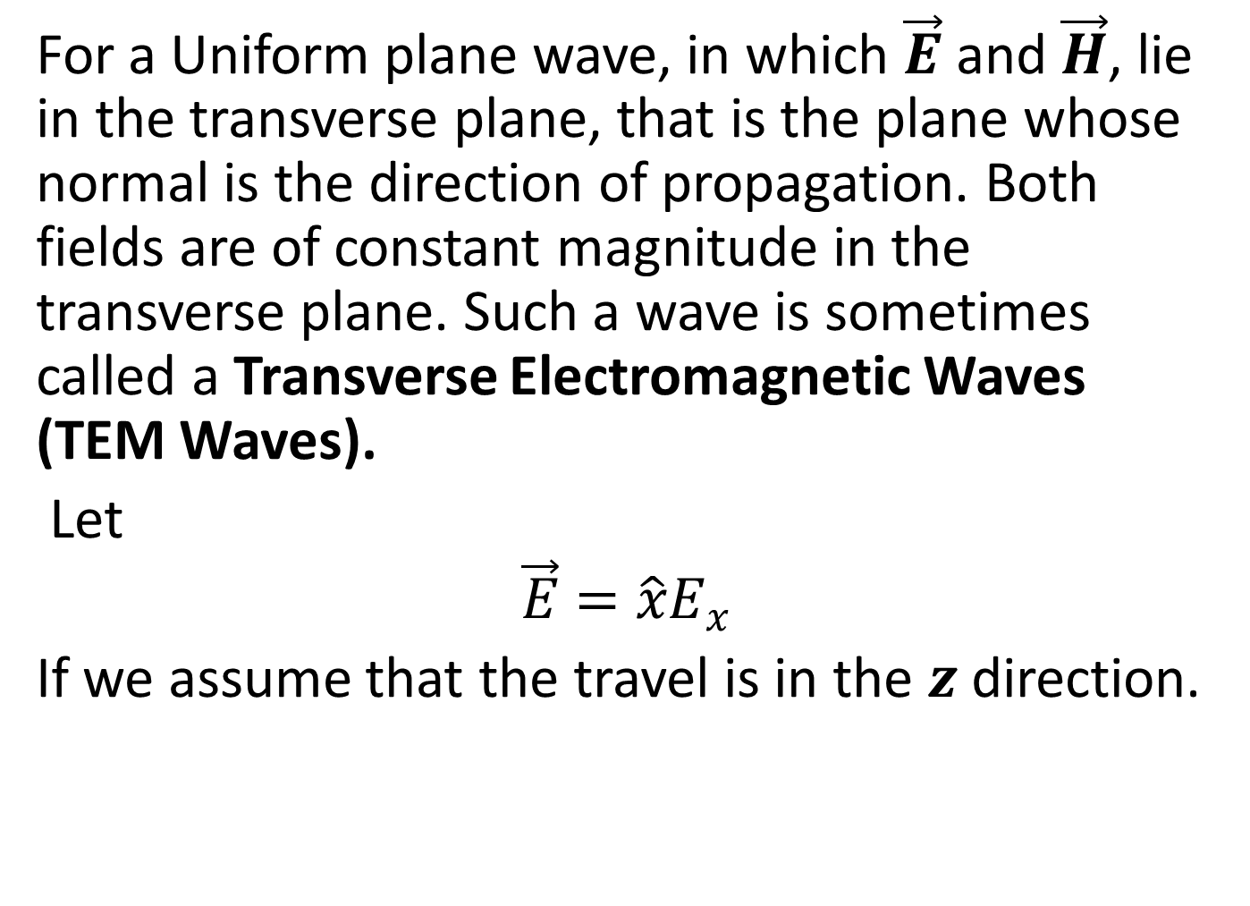
For a Uniform plane wave, in which $\vec{E}$ and $\vec{H}$, lie in the transverse plane, that is the plane whose normal is the direction of propagation. Both fields are of constant magnitude in the transverse plane. Such a wave is sometimes called a Transverse Electromagnetic Waves (TEM Waves).
Let
$$\vec{E}=\hat{x}E_{x}$$
If we assume that the travel is in the $z$ direction.

Slide 16
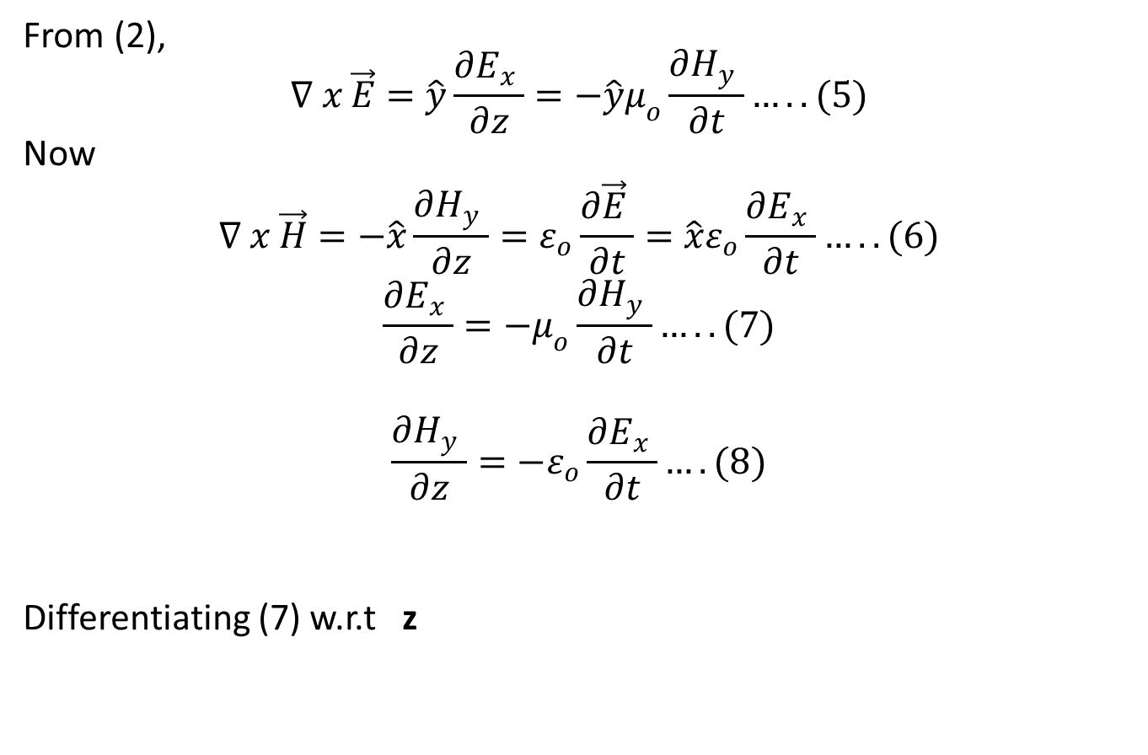
From (2),
$$∇ x \vec{E}=\hat{y}\frac{∂E_{x} }{∂z}=−\hat{y}μ_{o}\frac{∂H_{y} }{∂t}…..(5)$$
Now
$$∇ x \vec{H}=−\hat{x}\frac{∂H_{y} }{∂z}=ε_{o}\frac{∂\vec{E} }{∂t}=\hat{x}ε_{o}\frac{∂E_{x} }{∂t}…..(6)$$
$$\frac{∂E_{x} }{∂z}=−μ_{o}\frac{∂H_{y} }{∂t}…..(7)$$
$$\frac{∂H_{y} }{∂z}=−ε_{o}\frac{∂E_{x} }{∂t}….(8)$$
Differentiating (7) w.r.t z

Slide 17
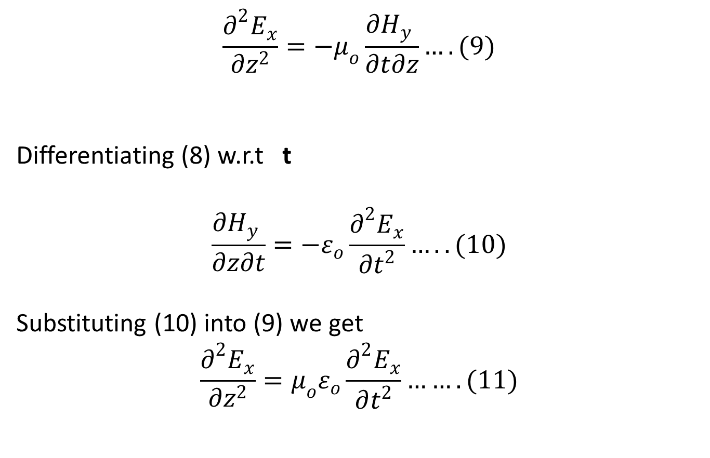
$$\frac{∂^{2}E_{x}}{∂z^{2}}=−μ_{o}\frac{∂H_{y} }{∂t∂z}….(9)$$
Differentiating (8) w.r.t t
$$\frac{∂H_{y} }{∂z∂t}=−ε_{o}\frac{∂^{2}E_{x}}{∂t^{2}}…..(10)$$
Substituting (10) into (9) we get
$$\frac{∂^{2}E_{x}}{∂z^{2}}=μ_{o}ε_{o}\frac{∂^{2}E_{x}}{∂t^{2}}…….(11)$$

Slide 18
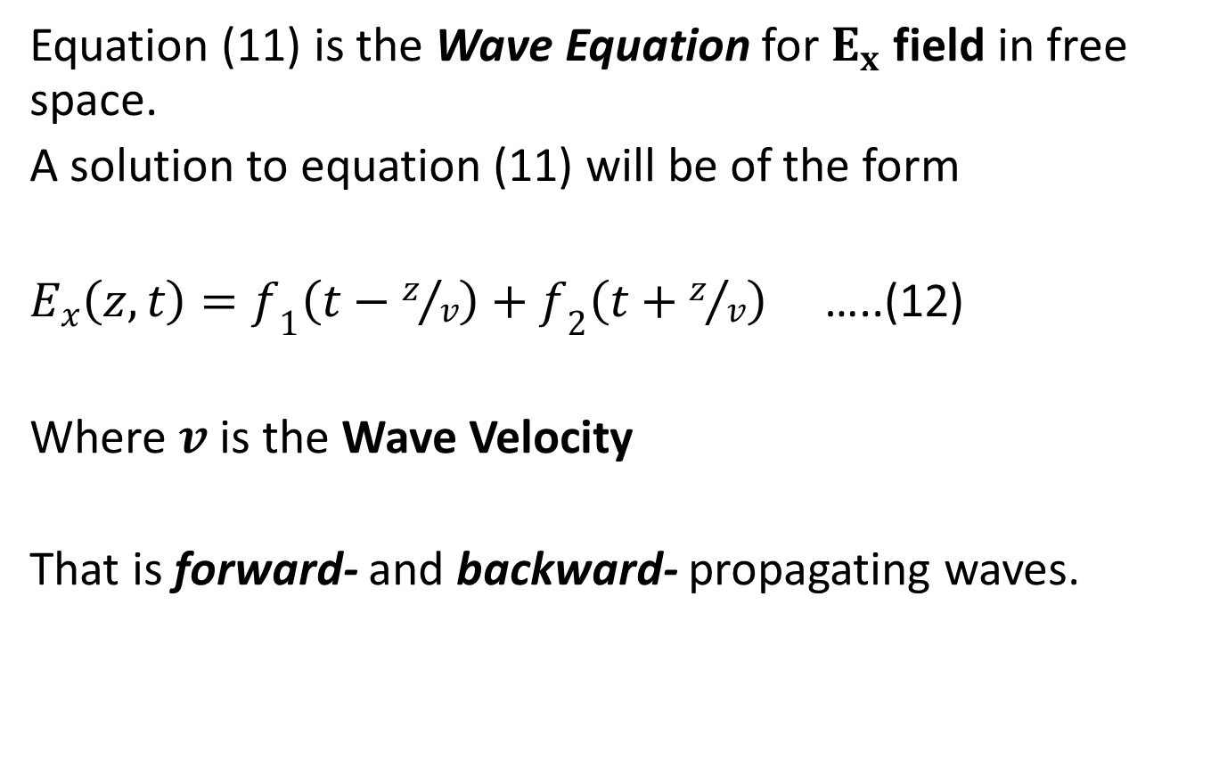
Equation (11) is the Wave Equation for $E_{x}$ field in free space.
A solution to equation (11) will be of the form
$E_{x}\left(z,t\right)=f_{1}\left(t−z/v\right)+f_{2}\left(t+z/v\right)$ …..(12)
Where $v$ is the Wave Velocity
That is forward- and backward- propagating waves.

Slide 19
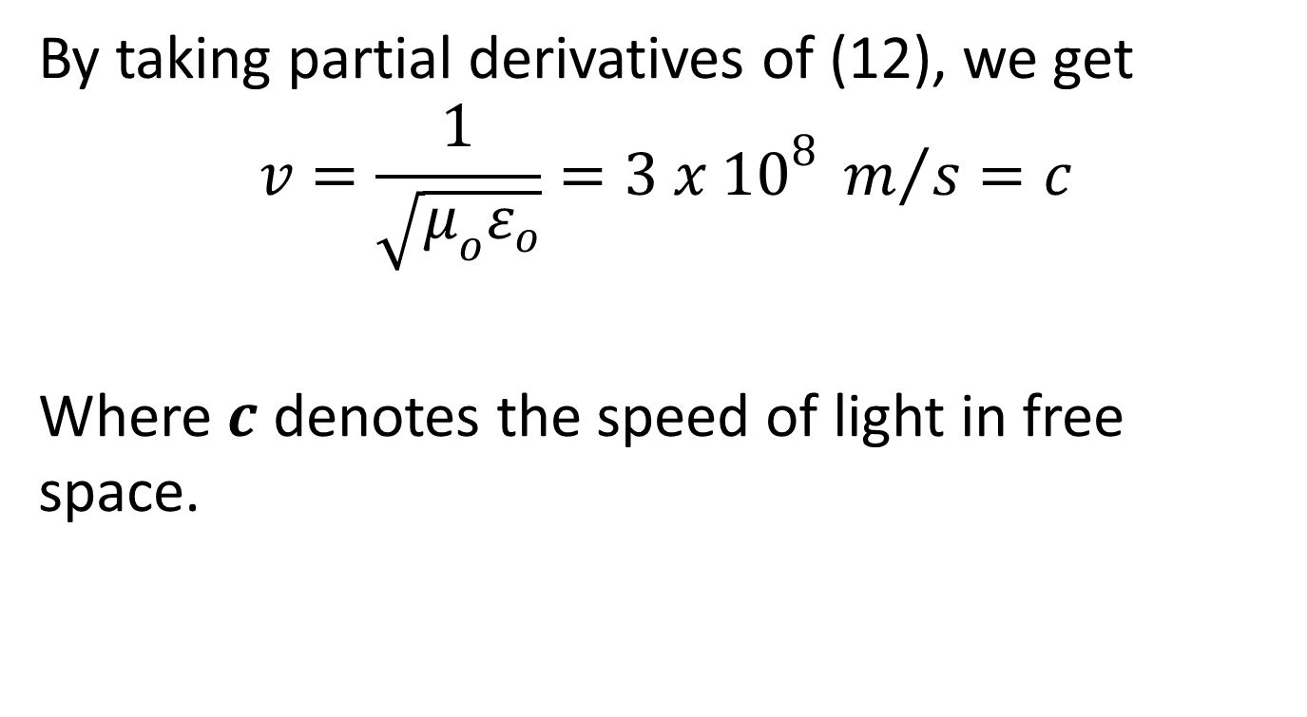
By taking partial derivatives of (12), we get
$$v=\frac{1}{\sqrt{μ_{o}ε_{o}}}=3 x {10}^{8} m/s=c$$
Where $c$ denotes the speed of light in free space.

Slide 20
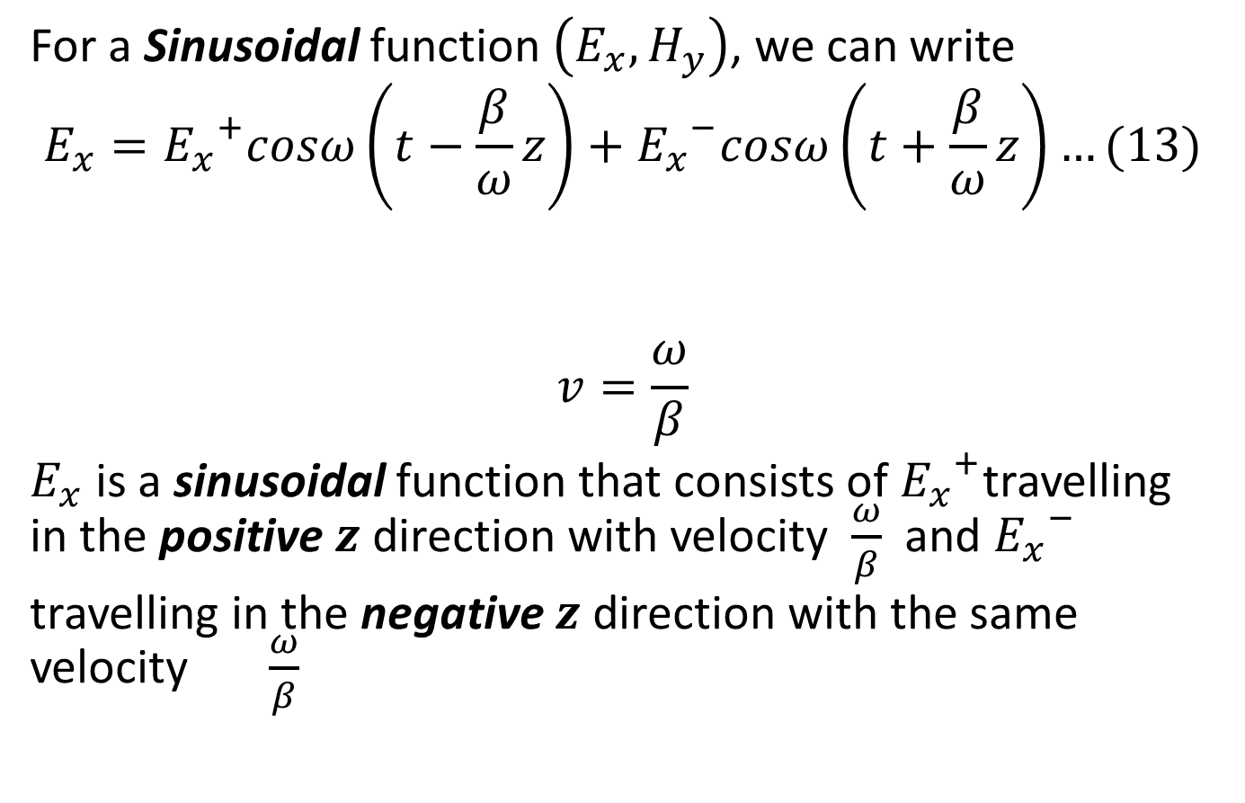
For a Sinusoidal function $\left(E_{x},H_{y}\right)$, we can write
$$E_{x}={E_{x}}^{+}cosω\left(t−\frac{β}{ω}z\right)+{E_{x}}^{−}cosω\left(t+\frac{β}{ω}z\right)…(13)$$
$$v=\frac{ω}{β}$$
$E_{x}$ is a sinusoidal function that consists of ${E_{x}}^{+}$travelling in the positive $z$ direction with velocity $\frac{ω}{β}$ and ${E_{x}}^{−}$
travelling in the negative $z$ direction with the same velocity $\frac{ω}{β}$

Slide 21
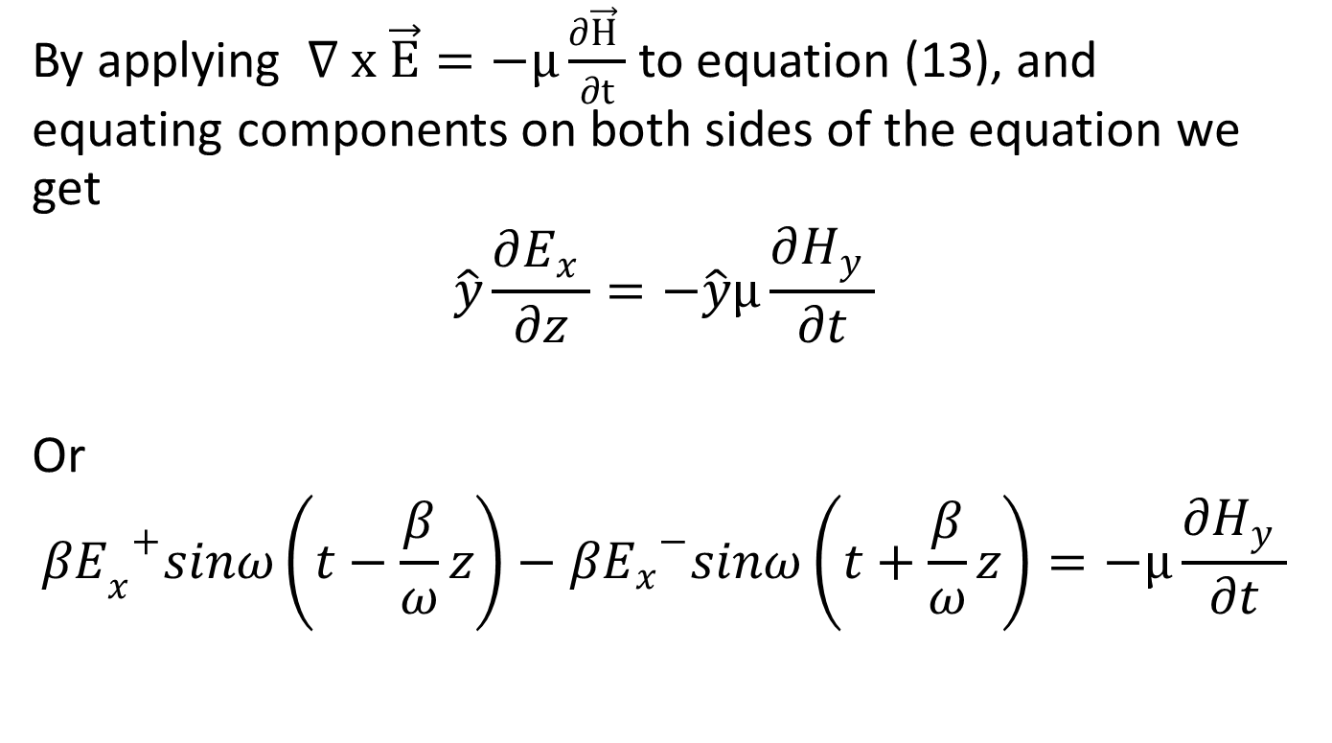
By applying $∇ x \vec{E}=−µ\frac{∂\vec{H} }{∂t}$ to equation (13), and equating components on both sides of the equation we get
$$\hat{y}\frac{∂E_{x} }{∂z}=−\hat{y}µ\frac{∂H_{y} }{∂t}$$
Or
$${{βE}_{x}}^{+}sinω\left(t−\frac{β}{ω}z\right)−{βE_{x}}^{−}sinω\left(t+\frac{β}{ω}z\right)=−µ\frac{∂H_{y} }{∂t}$$

Slide 22
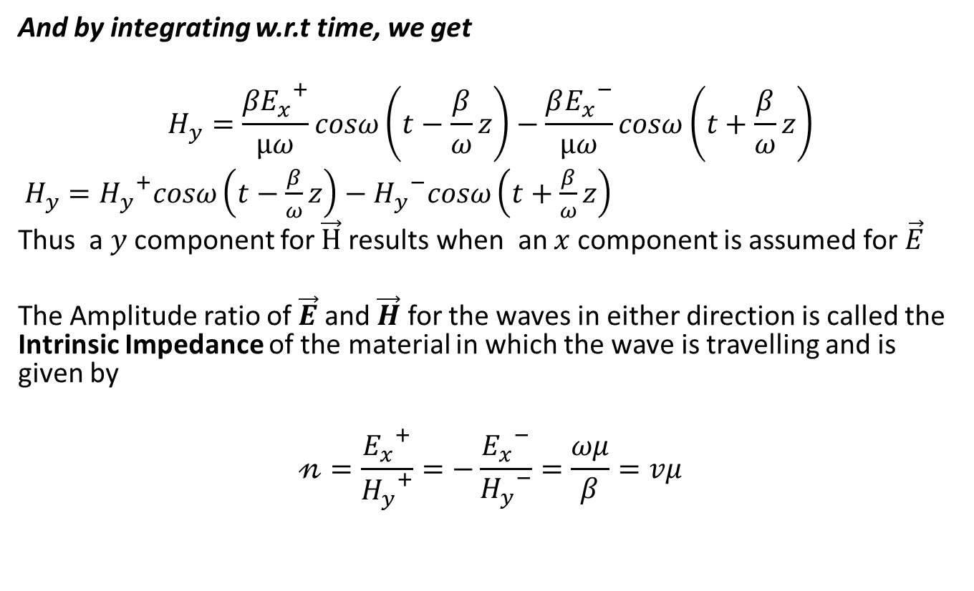
And by integrating w.r.t time, we get
$$H_{y}=\frac{{{βE}_{x}}^{+}}{µω}cosω\left(t−\frac{β}{ω}z\right)−\frac{{βE_{x}}^{−}}{µω}cosω\left(t+\frac{β}{ω}z\right)$$
$H_{y}={H_{y}}^{+}cosω\left(t−\frac{β}{ω}z\right)−{H_{y}}^{−}cosω\left(t+\frac{β}{ω}z\right)$
Thus a $y$component for $\vec{H}$results when an $x$ component is assumed for $\vec{E}$
The Amplitude ratio of $\vec{E}$ and $\vec{H}$ for the waves in either direction is called the Intrinsic Impedance of the material in which the wave is travelling and is given by
$$𝓃=\frac{{E_{x}}^{+}}{{H_{y}}^{+}}=−\frac{{E_{x}}^{−}}{{H_{y}}^{−}}=\frac{ωμ}{β}=vμ$$

Slide 23

Now $v=\frac{1}{\sqrt{με}}$
$$𝓃=\frac{μ}{\sqrt{με}}=\sqrt{\frac{μ}{ε}}$$
For free space $𝓃_{o}=\sqrt{\frac{μ_{o}}{ε_{o}}}=377Ω=120π$
$v=\frac{1}{\sqrt{μ_{o}ε_{o}}}=3 x {10}^{8} m/s$
$β$ is called the Phase Constant (also known as propagation constant or wave number)
If $λ$ is the wavelength in meters, then
$$β=\frac{2π}{λ}=\frac{ω}{v}=\frac{2πf}{v}$$
$$β=ω\sqrt{με}$$

Slide 24
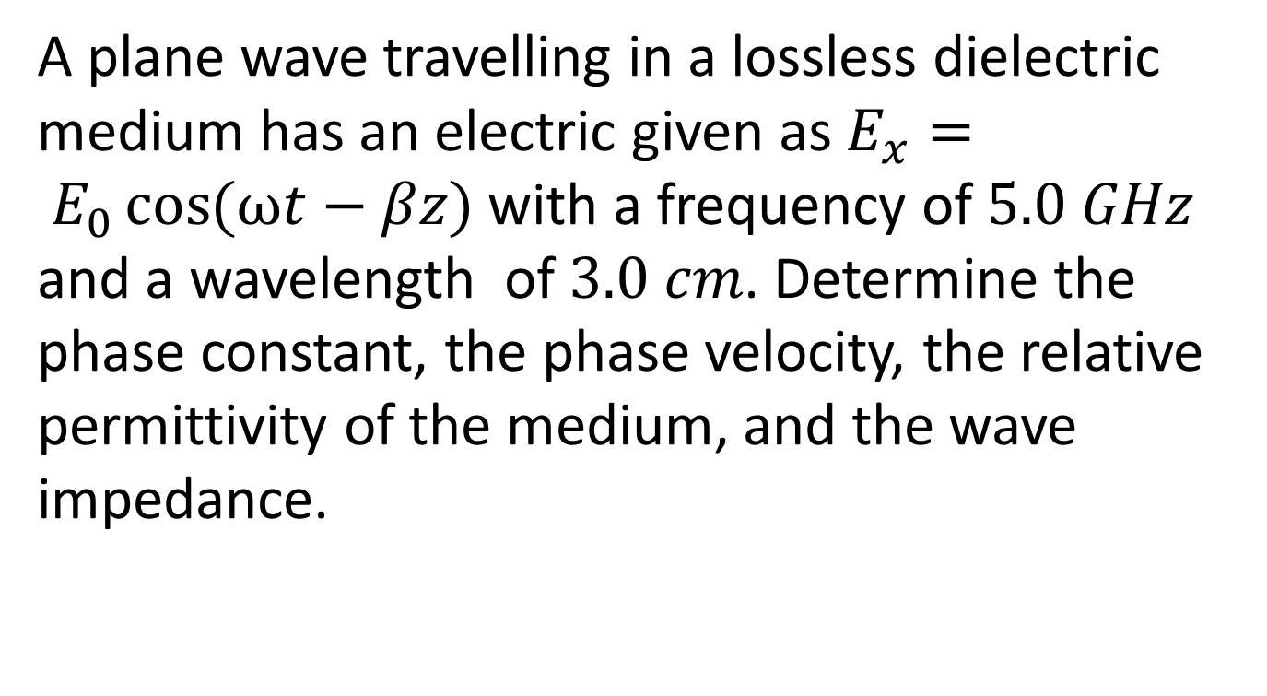
Example
A plane wave travelling in a lossless dielectric medium has an electric given as $E_{x}= E_{0}\cos{(ωt−βz)}$ with a frequency of $5.0 GHz$ and a wavelength of $3.0 cm$. Determine the phase constant, the phase velocity, the relative permittivity of the medium, and the wave impedance.

Slide 25
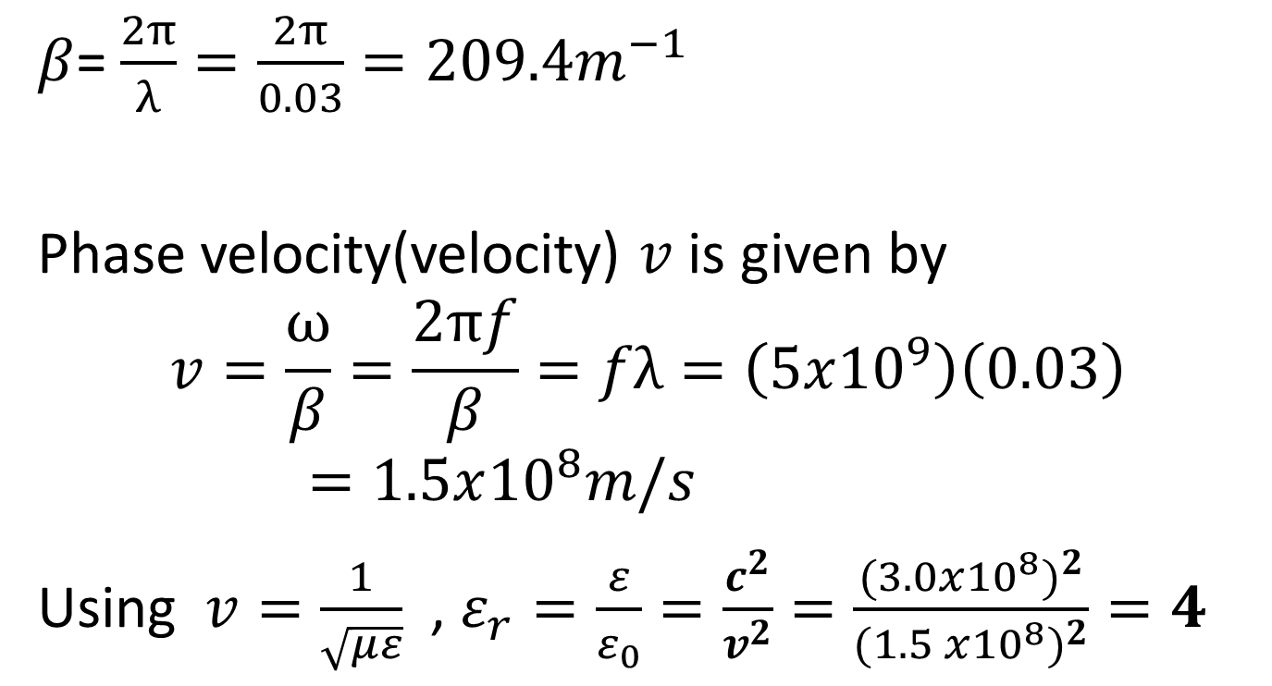
Solution
$β$= $\frac{2π}{λ}=\frac{2π}{0.03}=209.4m^{−1}$
Phase velocity(velocity) $v$ is given by
$$v=\frac{ω}{β}=\frac{2πf}{β}=fλ=\left(5x{10}^{9}\right)\left(0.03\right)=1.5x{10}^{8}m/s$$
Using $v=\frac{1}{\sqrt{με}}$ , $ε_{r}=\frac{ε}{ε_{0}}=\frac{c^{2}}{v^{2}}=\frac{{(3.0x{10}^{8})}^{2}}{{(1.5 x{10}^{8})}^{2}}=4$

Slide 26

The wave impedance $𝓃=\frac{μ}{\sqrt{με}}=\sqrt{\frac{μ}{ε}}$
$$𝓃=\frac{𝓃_{0}}{\sqrt{ε_{r}}}=\frac{377}{\sqrt{4}}=188.5 Ω$$

Slide 27
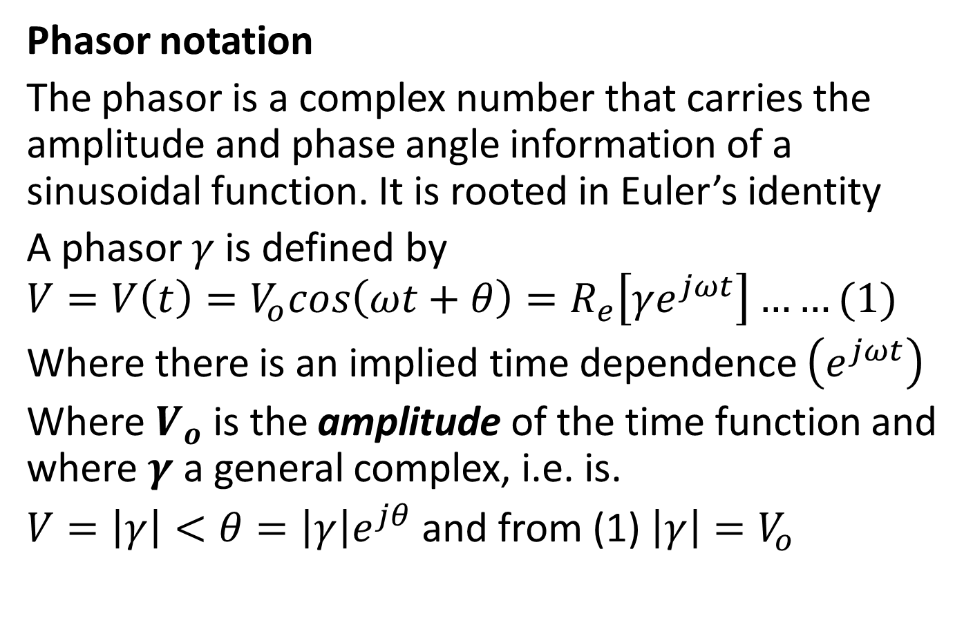
LOSSY DIELECTRICS
Phasor notation
The phasor is a complex number that carries the amplitude and phase angle information of a sinusoidal function. It is rooted in Euler’s identity
A phasor $γ$ is defined by $V=V\left(t\right)=V_{o}cos\left(ωt+θ\right)=R_{e}\left[γe^{jωt}\right]……(1)$
Where there is an implied time dependence $\left(e^{jωt}\right)$
Where $V_{o}$ is the amplitude of the time function and where $γ$ a general complex, i.e. is.
$V=\left|γ\right|<θ=\left|γ\right|e^{jθ}$ and from (1) $\left|γ\right|=V_{o}$

Slide 28
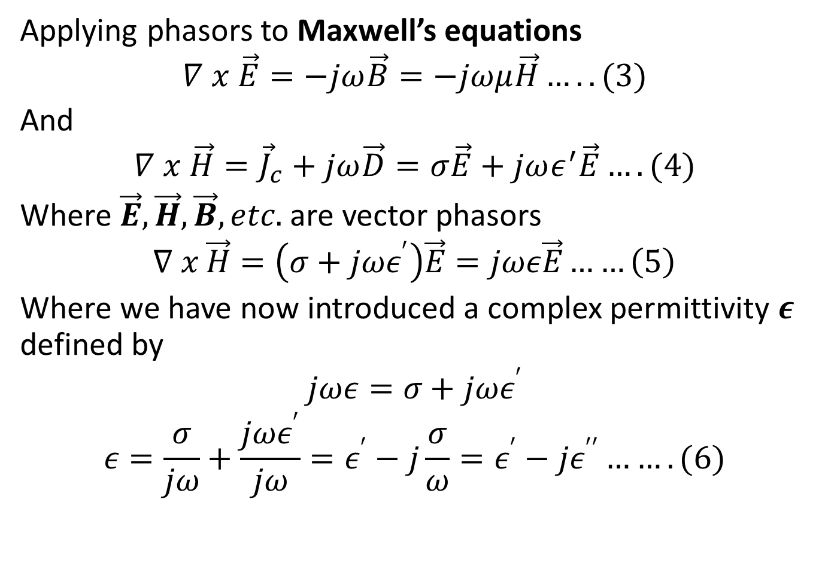
Applying phasors to Maxwell’s equations
$$∇ x \vec{E}=−jω\vec{B}=−jωμ\vec{H}…..(3)$$
And
$$∇ x \vec{H}={\vec{J}}_{c}+jω\vec{D}=σ\vec{E}+jωε^{′}\vec{E}….(4)$$
Where $\vec{E},\vec{H},\vec{B},etc.$ are vector phasors
$$∇ x \vec{H}=\left(σ+jωε^{′}\right)\vec{E}=jωε\vec{E}……\left(5\right)$$
Where we have now introduced a complex permittivity $ε$ defined by
$$jωε=σ+jωε^{′}$$
$$ε=\frac{σ}{jω}+\frac{jωε^{′}}{jω}=ε^{′}−j\frac{σ}{ω}=ε^{′}−jε^{′′}…….(6)$$

Slide 29
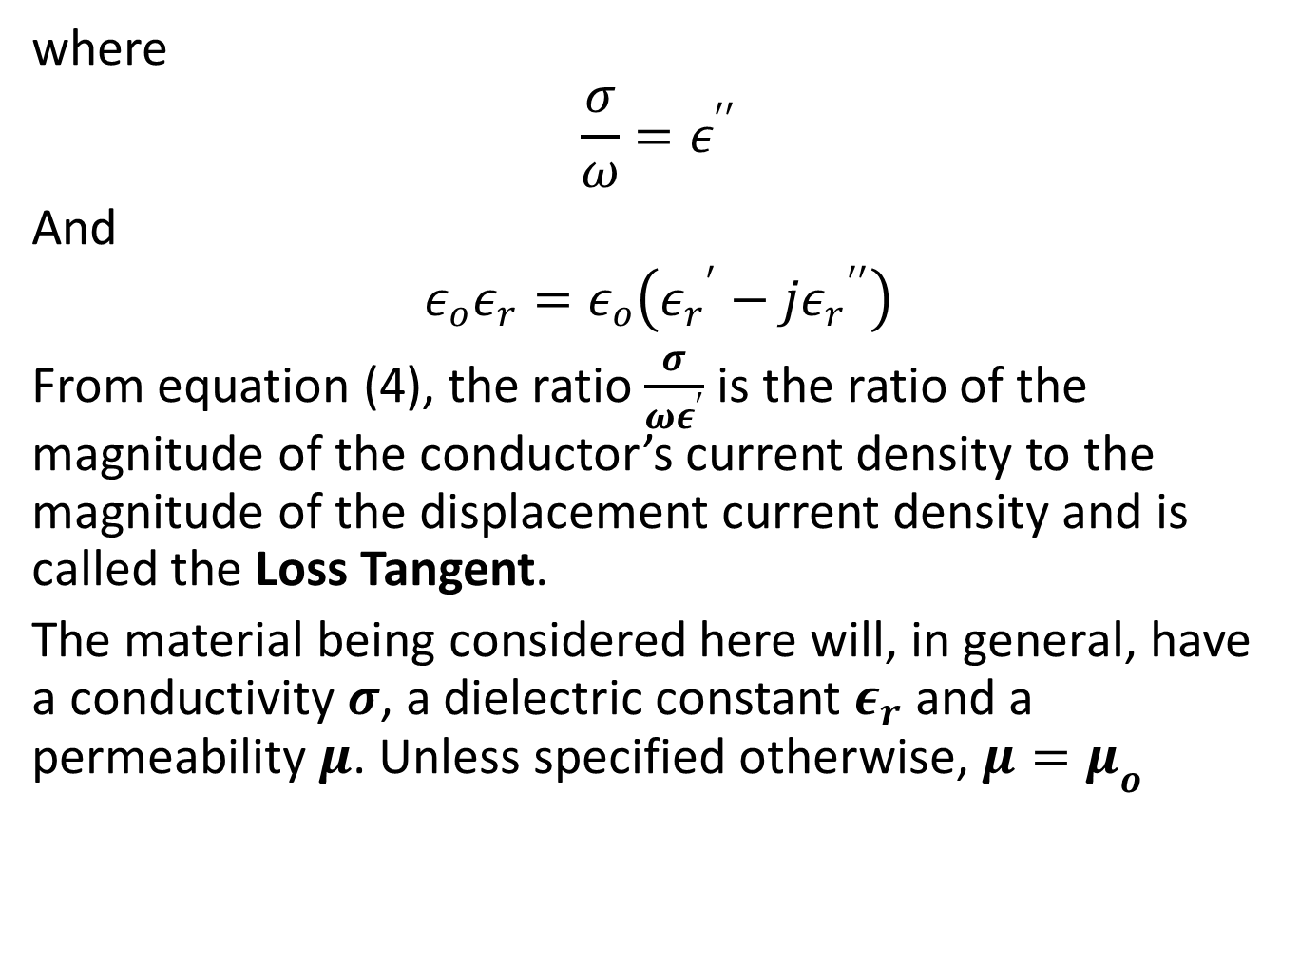
where
$$\frac{σ}{ω}=ε^{′′}$$
And
$$ε_{o}ε_{r}=ε_{o}\left({ε_{r}}^{′}−j{ε_{r}}^{′′}\right)$$
From equation (4), the ratio $\frac{σ}{ωε^{′}}$ is the ratio of the magnitude of the conductor’s current density to the magnitude of the displacement current density and is called the Loss Tangent.
The material being considered here will, in general, have a conductivity $σ$, a dielectric constant $ε_{r}$ and a permeability $μ$. Unless specified otherwise, $μ=μ_{o}$

Slide 30
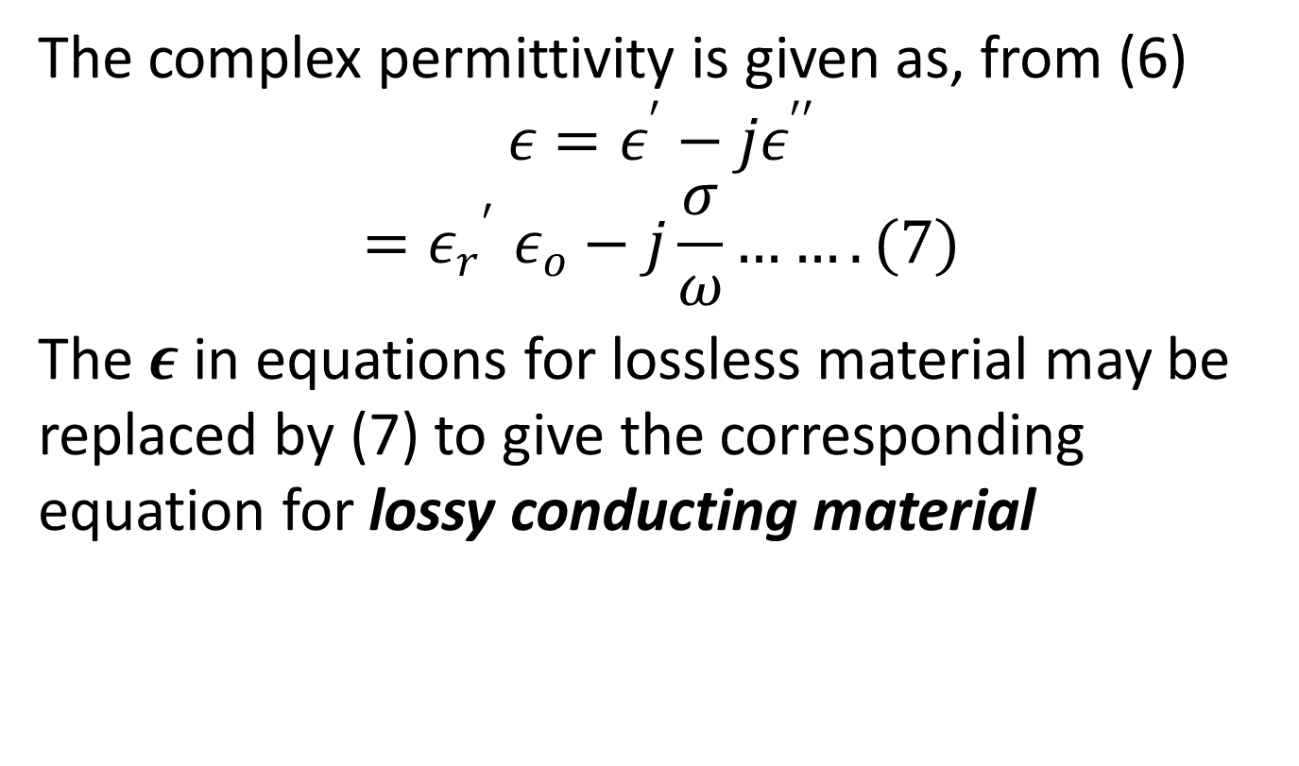
The complex permittivity is given as, from (6)
$$ε=ε^{′}−jε^{′′}$$
$${{=ε}_{r}}^{′}ε_{o}−j\frac{σ}{ω}…….(7)$$
The $ε$ in equations for lossless material may be replaced by (7) to give the corresponding equation for lossy conducting material

Slide 31
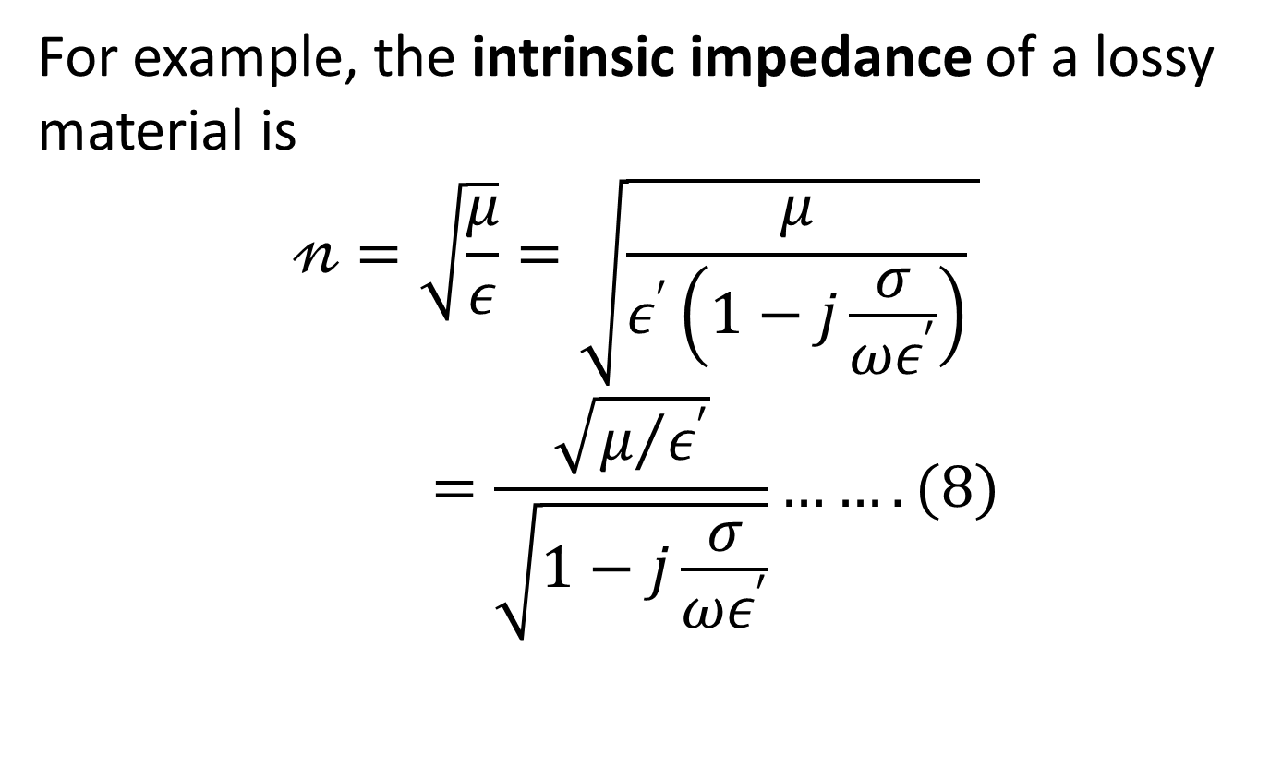
For example, the intrinsic impedance of a lossy material is
$$𝓃=\sqrt{\frac{μ}{ε}}=\sqrt{\frac{μ}{ε^{′}\left(1−j\frac{σ}{ωε^{′}}\right)} }=\frac{\sqrt{μ/{ε^{′}}}}{\sqrt{1−j\frac{σ}{ωε^{′}}}}…….(8)$$

Slide 32
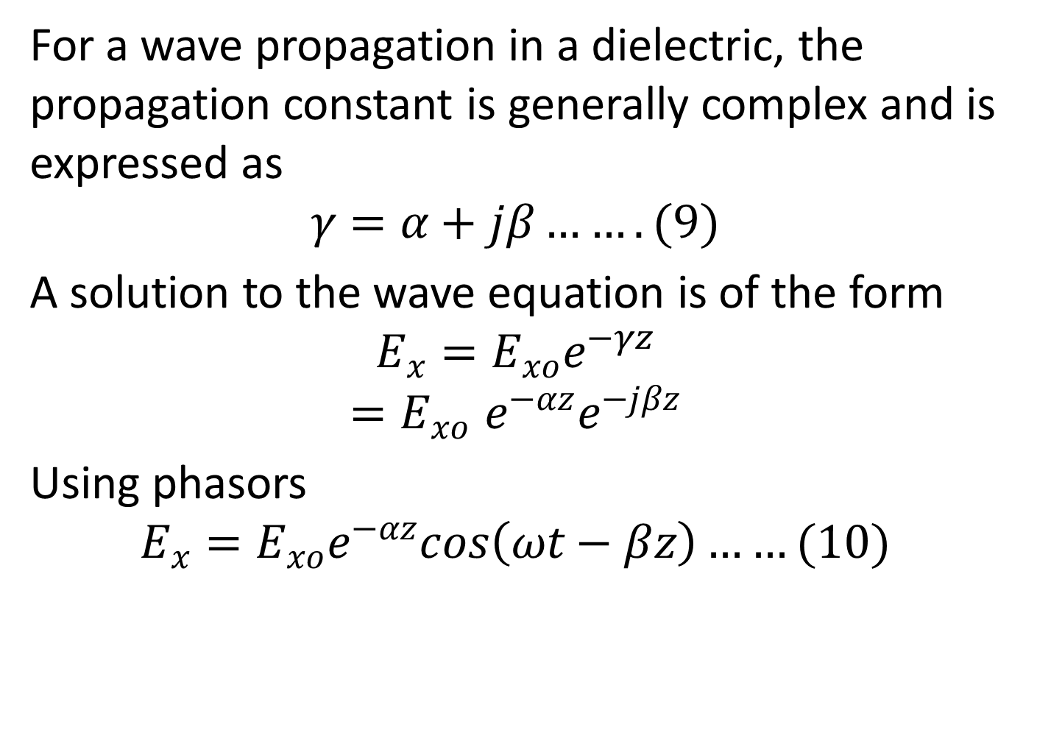
For a wave propagation in a dielectric, the propagation constant is generally complex and is expressed as
$$γ=α+jβ…….(9)$$
A solution to the wave equation is of the form
$$E_{x}=E_{xo}e^{−γz}$$
$${=E}_{xo}e^{−αz}e^{−jβz}$$
Using phasors
$$E_{x}=E_{xo}e^{−αz}cos\left(ωt−βz\right)……(10)$$

Slide 33
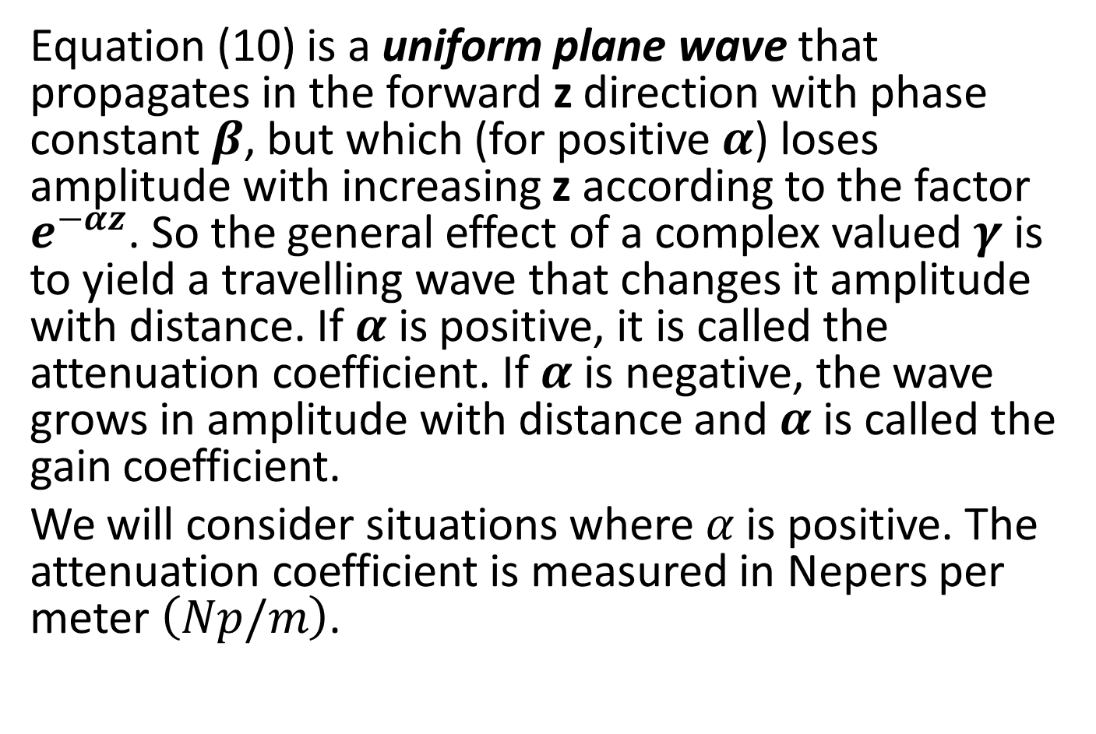
Equation (10) is a uniform plane wave that propagates in the forward z direction with phase constant $β$, but which (for positive $α$) loses amplitude with increasing z according to the factor $e^{−αz}$. So the general effect of a complex valued $γ$ is to yield a travelling wave that changes it amplitude with distance. If $α$ is positive, it is called the attenuation coefficient. If $α$ is negative, the wave grows in amplitude with distance and $α$ is called the gain coefficient.
We will consider situations where $α$ is positive. The attenuation coefficient is measured in Nepers per meter $\left(Np/m\right)$.

Slide 34



Slide 35
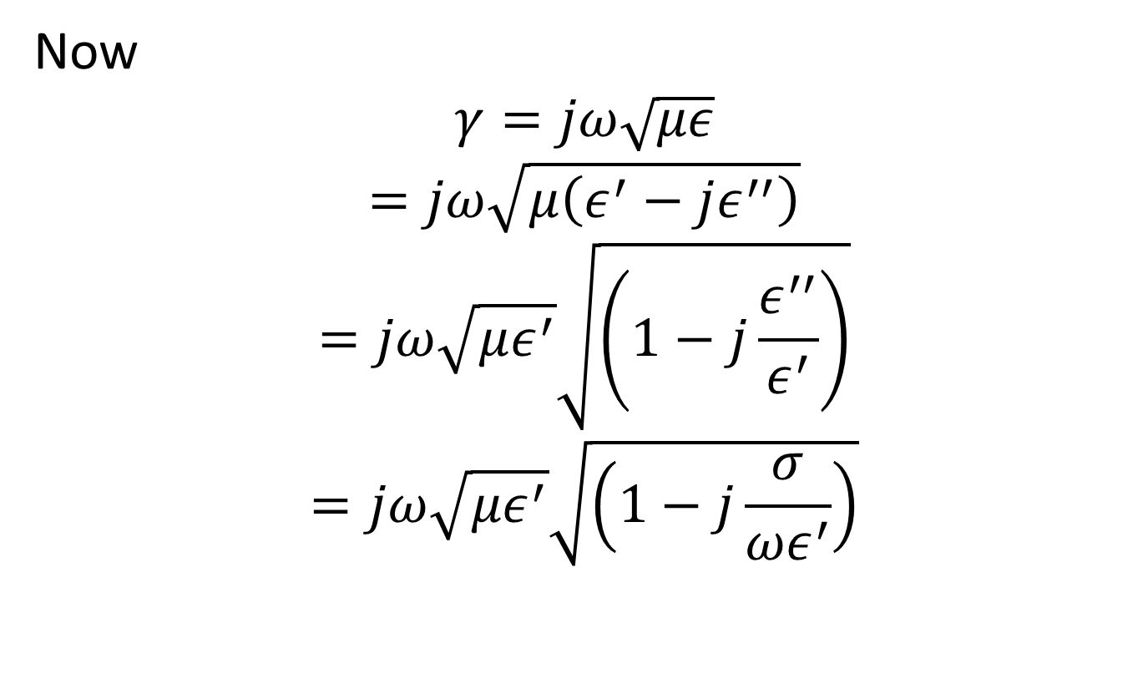
Now
$$γ=jω\sqrt{με}$$
$$=jω\sqrt{μ\left(ε^{′}−jε^{′′}\right)}$$
$$=jω\sqrt{με^{′}}\sqrt{\left(1−j\frac{ε^{′′}}{ε^{′}}\right)}$$
$$=jω\sqrt{με^{′}}\sqrt{\left(1−j\frac{σ}{{ωε}^{′}}\right)}$$

Slide 36
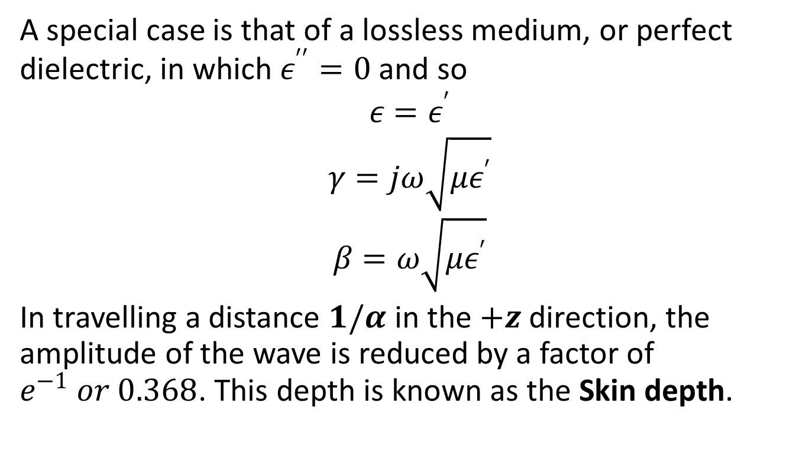
A special case is that of a lossless medium, or perfect dielectric, in which $ε^{′′}=0$ and so
$${ε=ε}^{′}$$
$$γ=jω\sqrt{με^{′}}$$
$$β=ω\sqrt{με^{′}}$$
In travelling a distance $1/α$ in the $+z$ direction, the amplitude of the wave is reduced by a factor of $e^{−1} or 0.368$. This depth is known as the Skin depth.

Slide 37
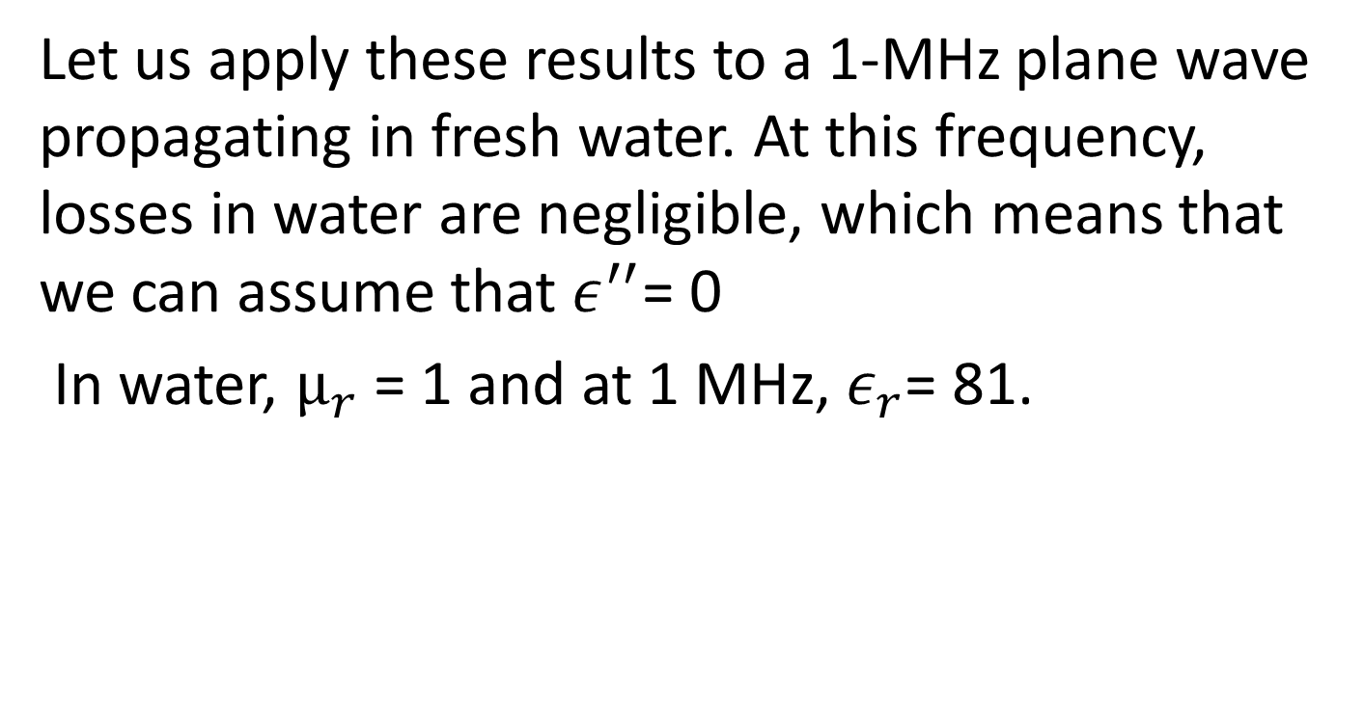
Example
Let us apply these results to a 1-MHz plane wave propagating in fresh water. At this frequency, losses in water are negligible, which means that we can assume that $ε^{′′}$= 0
In water, $µ_{r}$ = 1 and at 1 MHz, $ε_{r}$= 81.

Slide 38

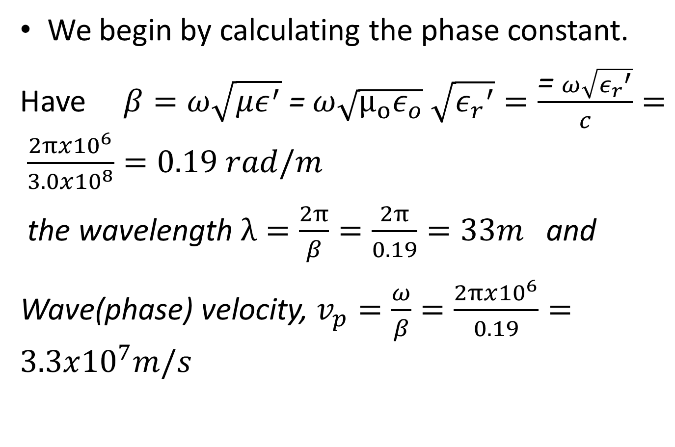
We begin by calculating the phase constant.
Have $β=ω\sqrt{με^{′}}$ = $ω\sqrt{{μ_{o}ε}_{o}}$ $\sqrt{{ε_{r}}^{′}}=\frac{\text{=} ω\sqrt{{ε_{r}}^{′}}}{c}= \frac{2πx{10}^{6}}{3.0x{10}^{8}}=0.19 rad/m$
the wavelength $λ=\frac{2π}{β}=\frac{2π}{0.19}=33m$ and
Wave(phase) velocity, $v_{p}=\frac{ω}{β}=\frac{2πx{10}^{6}}{0.19}=3.3x{10}^{7}m/s$

Slide 39


